Slide 1
UoBAR team presentation
Tudor Petrescu
Nolan Chen
Himanshu Bhandari
Dingbang Mao

Slide 2
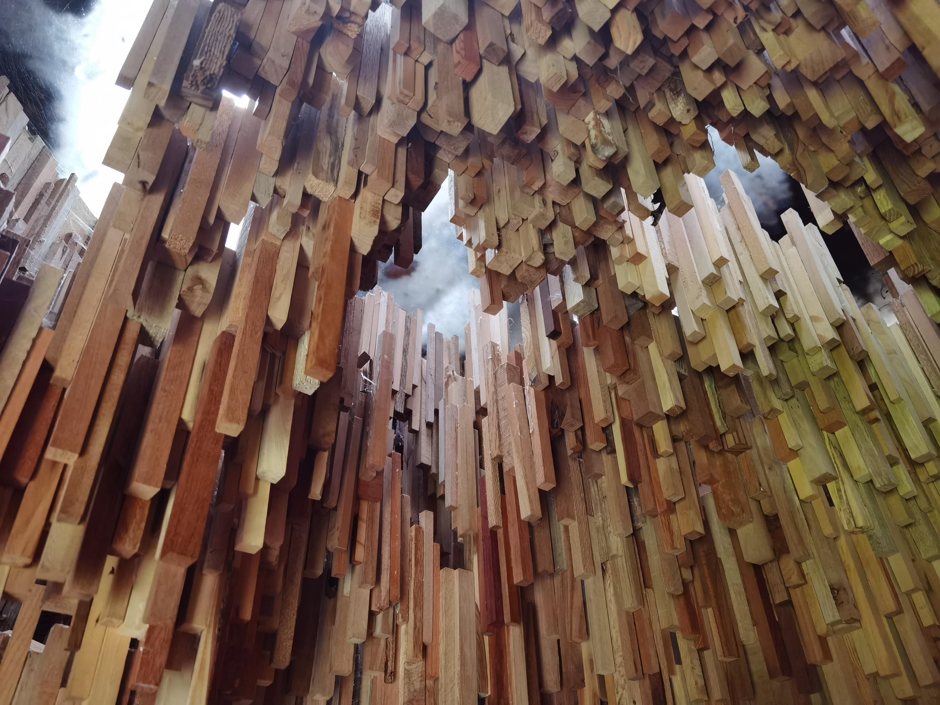
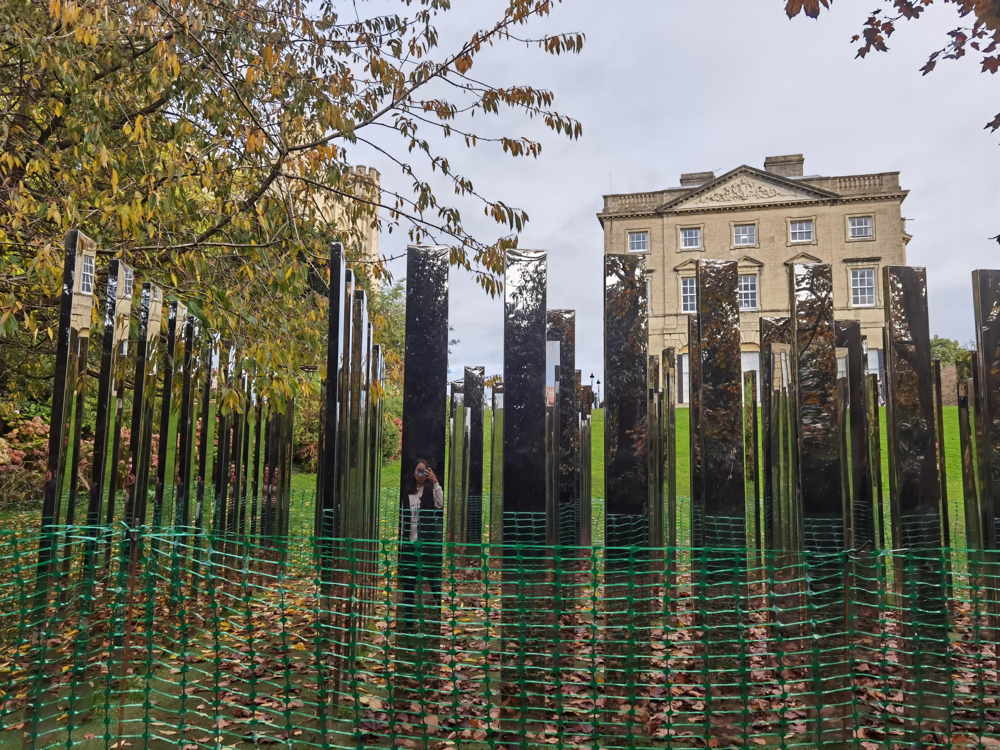
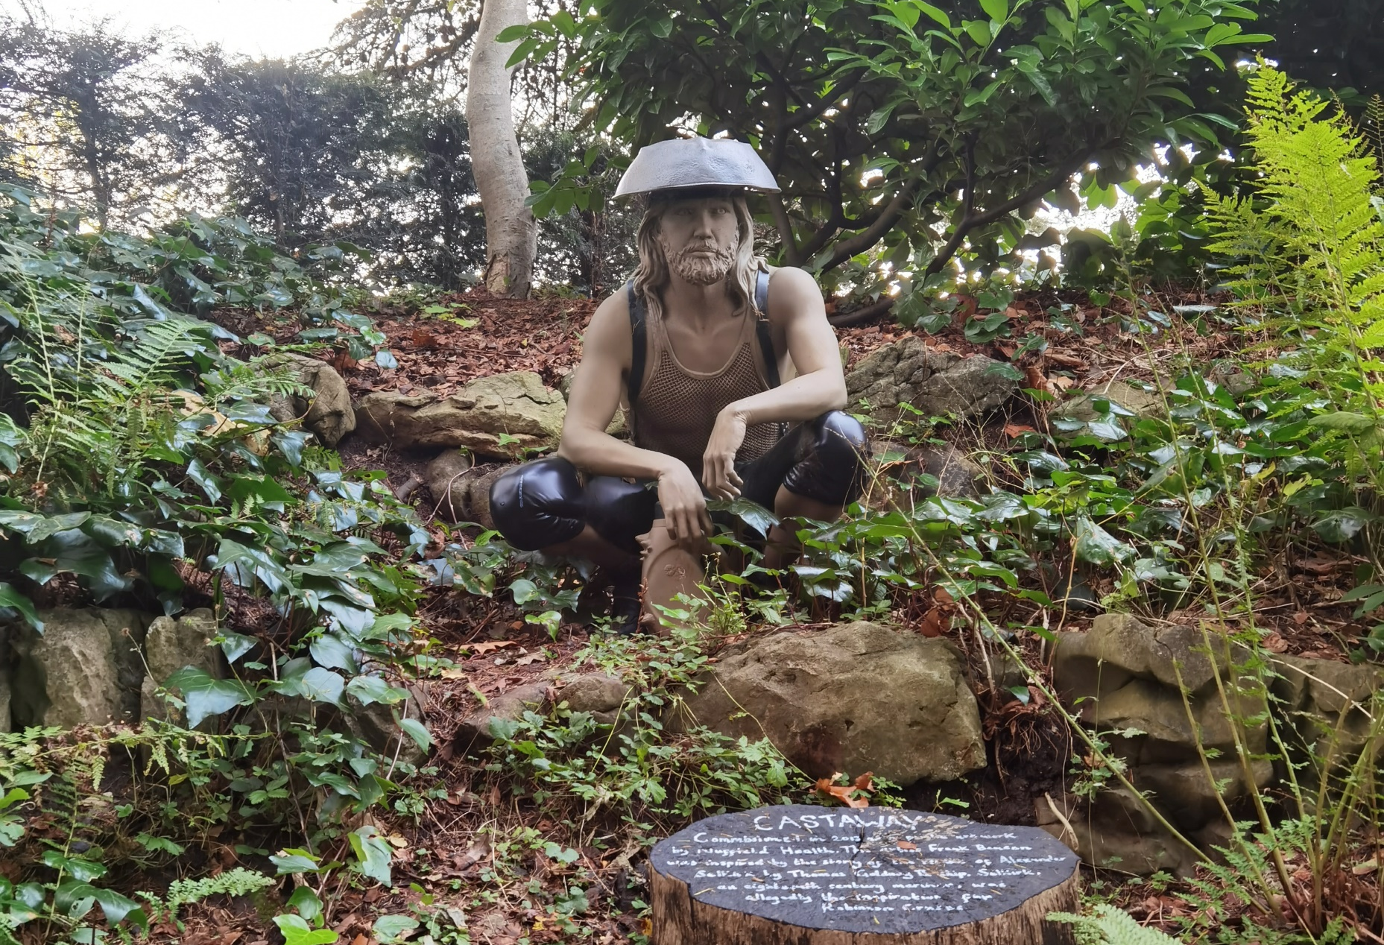
Context
Royal Fort Gardens and Goldney garden are two of the most beautiful gardens in Bristol
Both gardens contain a lot of art pieces
Information isn’t provided for all the art pieces
There is potential for something more with the help of technology
A website that contains all the relevant information and pictures is being built, so we must find a way to take advantage of that

Slide 3
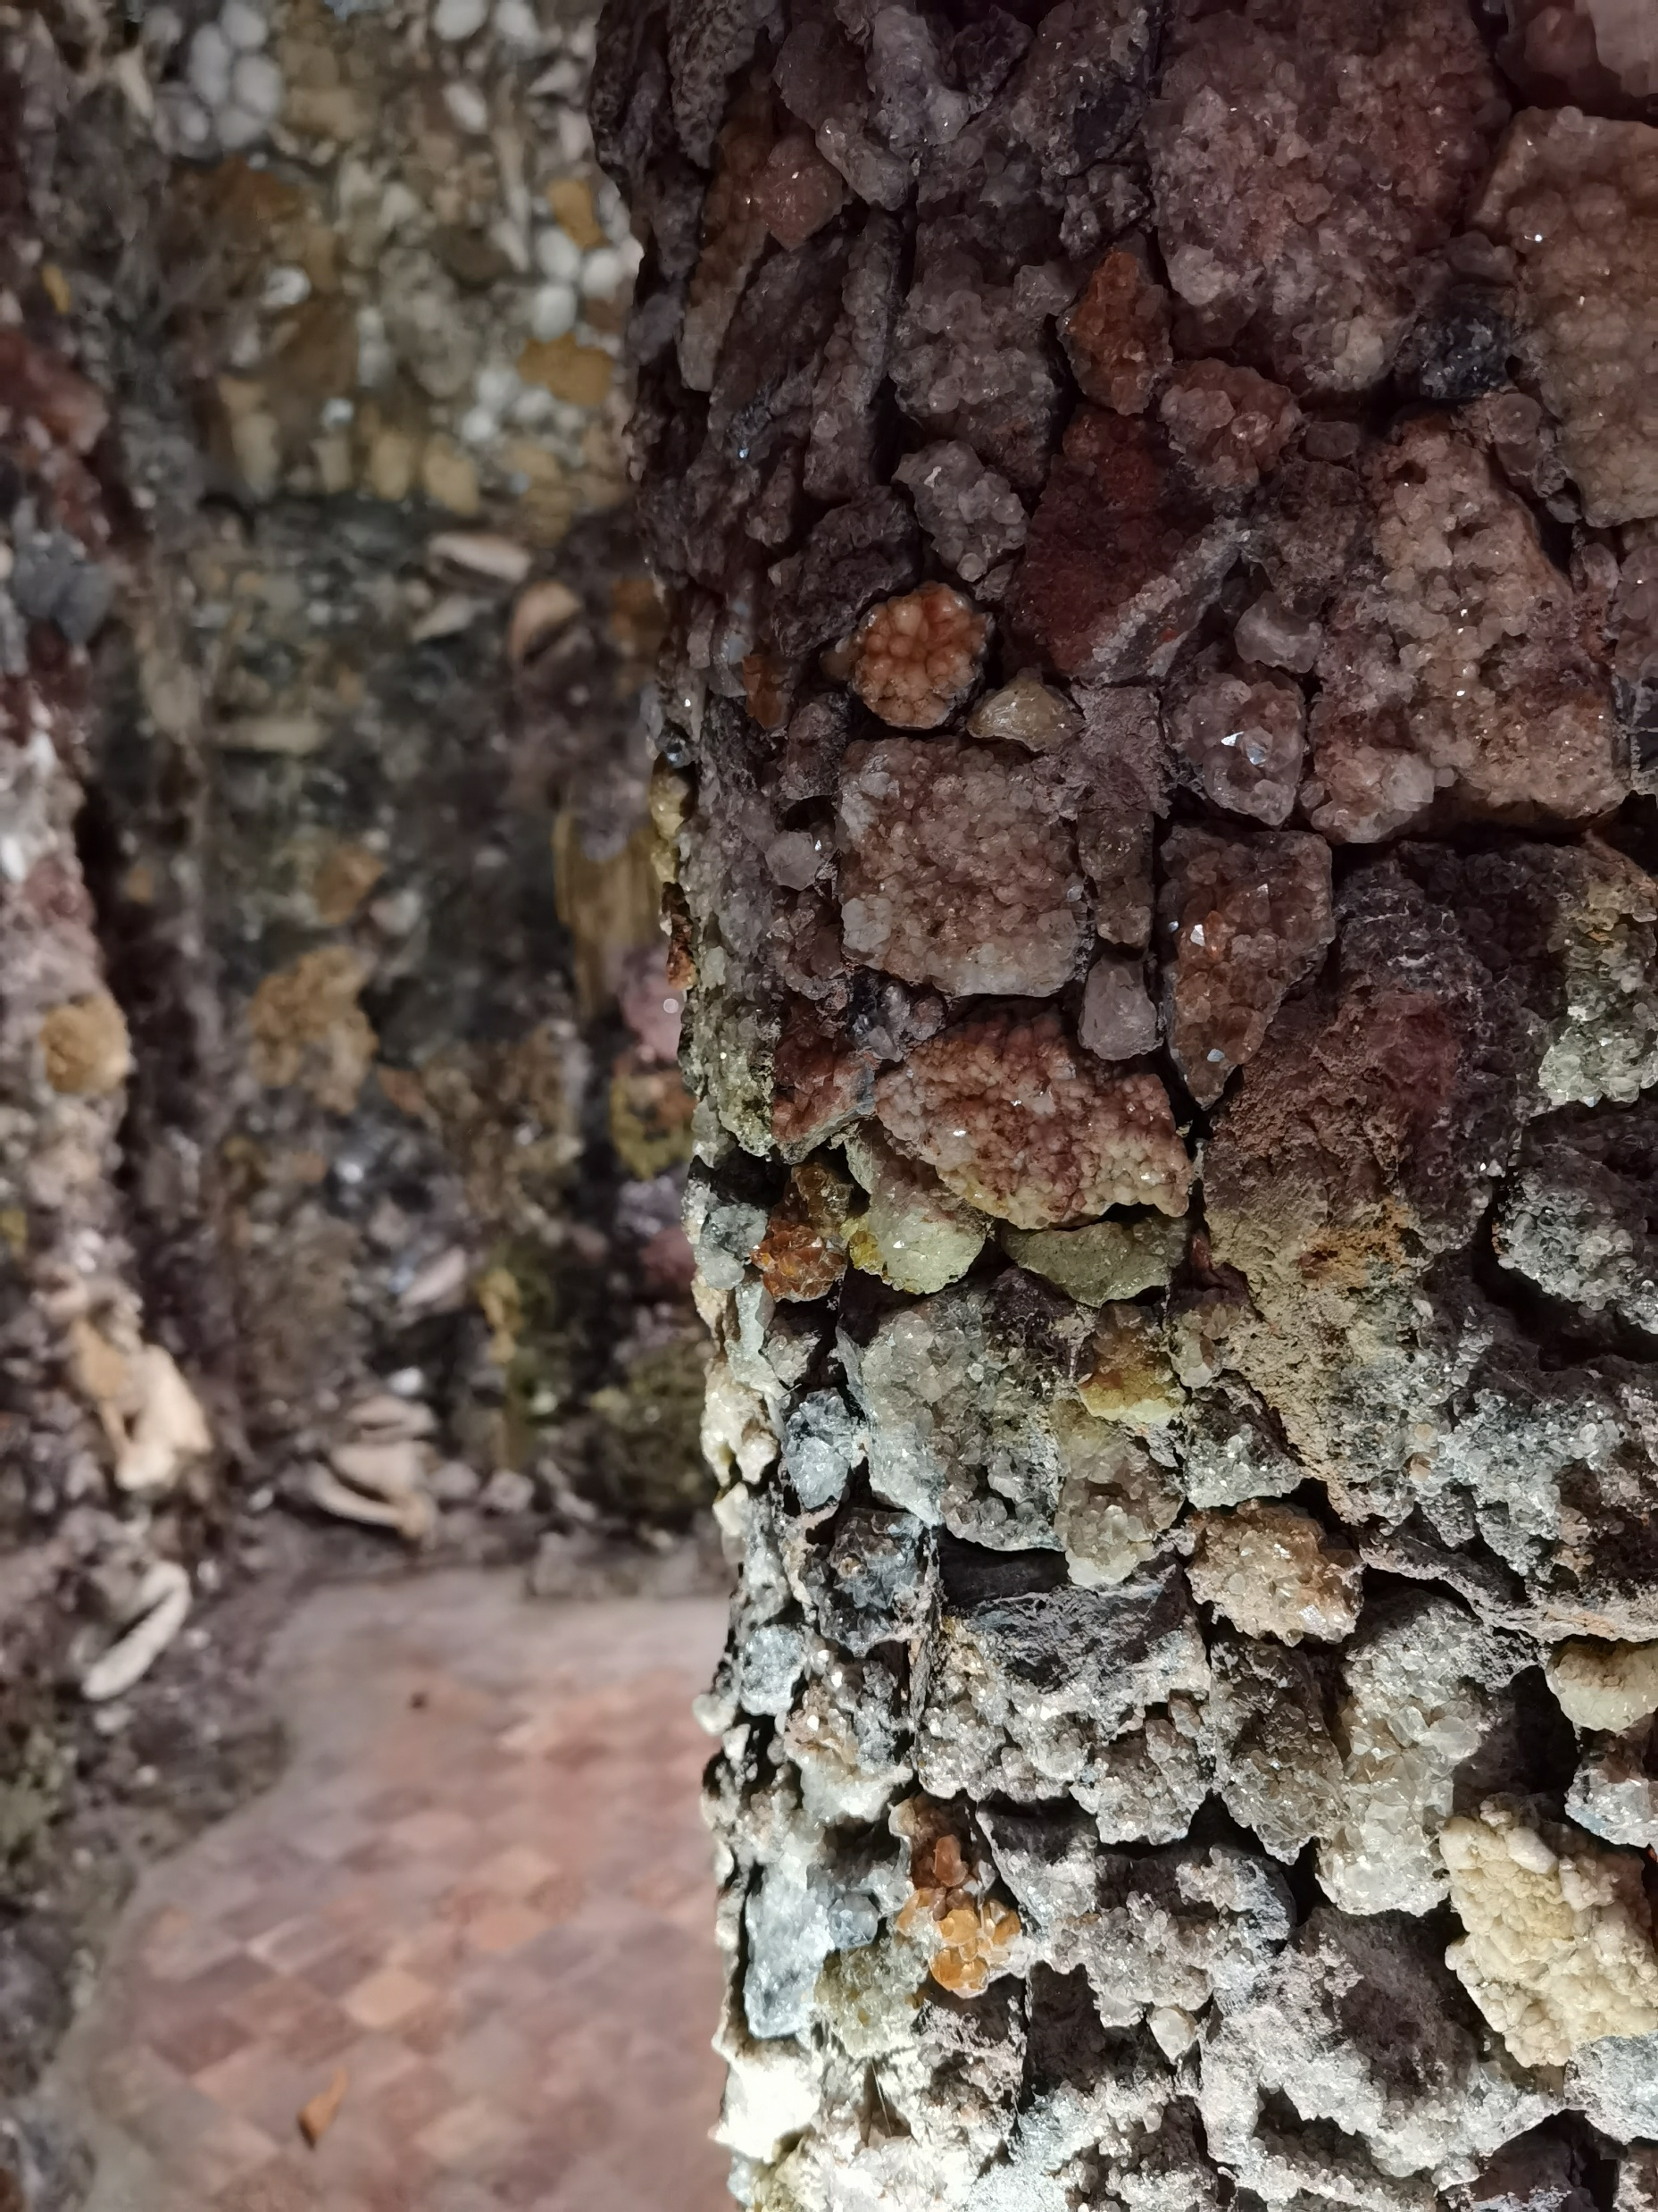
Opportunity
Needed a method to provide an interactive and unique experience for the visitors, and a way to bring the art pieces “to life”
The grotto is not accessible to those with mobility impairment, so there must be a way to enable them to experience it
The system needs to be appealing, easy to use and somewhat minimalist
The solution must be easily maintainable, since the Universities’ IT Services will be managing it

Slide 4
Solution
A mobile app that will have the ability to scan QR codes
The QR codes will link to an art piece to the specific page on the website that is being developed
The ability to create new QR codes is crucial, so that when a new piece is added, they can easily create a code and put it next to the art.
The app has to have extra features such as audio capabilities, in order to motivate people to download it

Slide 5
TB2 Project Plans
Decouple the app
Decouple the QR decoder from the QR encoder (i.e., create a separate app which will generate QR codes, as the general public doesn’t need to access this feature)
Add audio
Add the option to scan a QR code which will bring an audio alternative to the website, so that people with visual impairment can also get to experience the information about the art
Navigation features
Enable visitors to the Royal Fort Garden and Goldney to use GPS to locate their current position and to identify where they need to go to discover locations of statues, art installations and other features of the garden
UI
Design the user interface (make it appealing to everyone that will visit the gardens and will use the app)
IOS
Look into translating the application to iOS so that people with an iOS device can use it as well

Slide 6
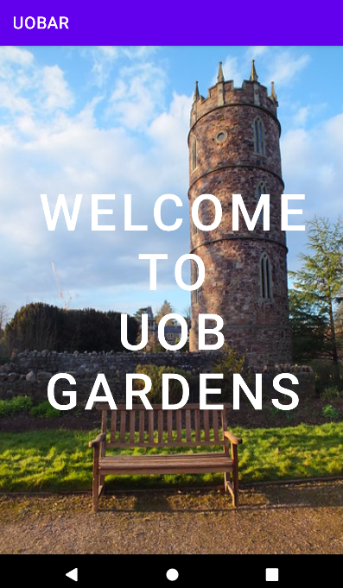
Current state of the app

Slide 7
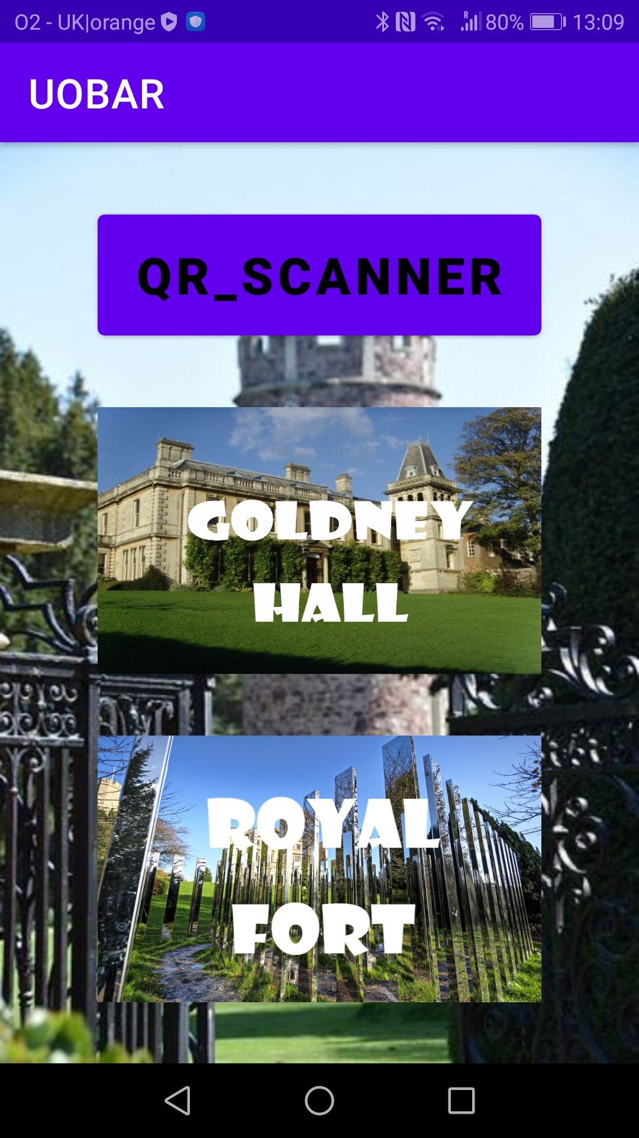
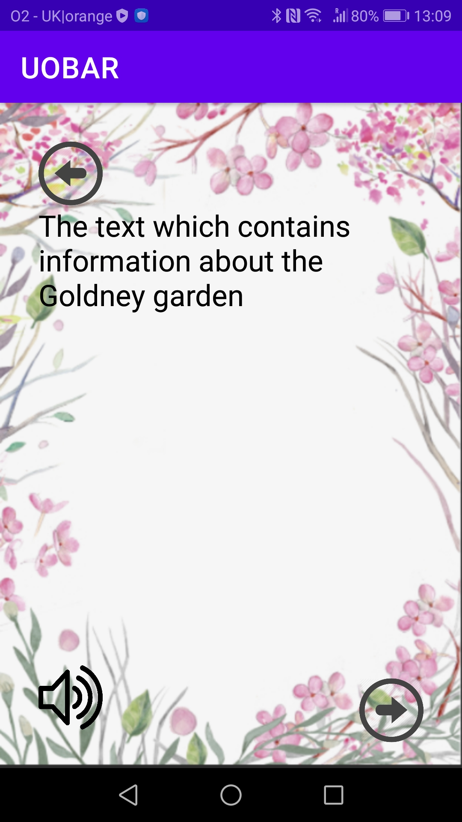
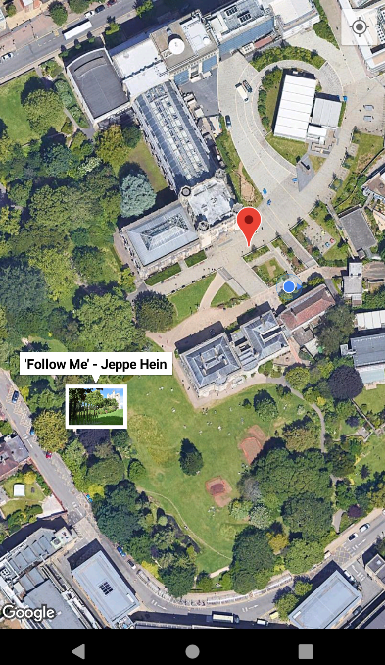

Slide 8
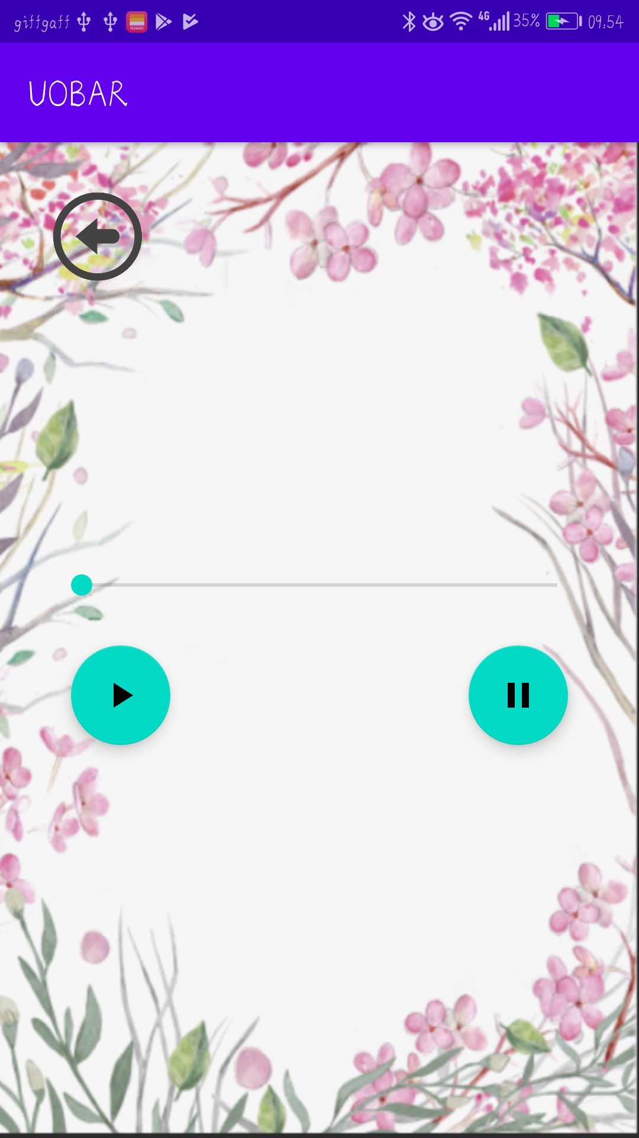
Current state
We have managed to achieve almost all of the desired features of the app
It now has a much nicer user interface
It also acts on 2 types of QR images:
On a link to a specific page on the website, it constructs the full link to that page and opens in in the default web browser
On an image which indicates an audio file, it opens that specific audio file, and the user can then play, pause and skip to a specific part in the audio file
If GPS is enabled, the app automatically chooses where the user is, otherwise, the user can choose the garden they are currently in; and then short a short description of that garden is given. The user can also opt for the audio version of the text.
We also have a map that displays the user's current location as well as a marker with all the art pieces; of which if you click on it will take you to the page of the said art piece.
Unfortunately, we do not have time to implement the iOS version of the app

Slide 9
Biggest lessons learnt
Anything is possible if there is enough time
We thought implementing audio and GPS features would be extremely difficult, turned out that with enough patience and dedication it can be manageable and somewhat easy to achieve
Key to a happy client is transparency
Even if little progress is made in a period of time, as long as you are honest about what is going on, the client will be happy, since it makes them feel included in the development process

